Slide 1

Queues: ADT Queue Operations: Create Add Delete Full and Empty
Data Structure | ADT: Stack and Queue
Course: Data Structure | Chapter: ADT: Stack and Queue | Bachelor of Engineering
DISCOVER · LEARN · EMPOWER
Notes:
Welcome everyone to today's lecture on Data Structures. We are focusing specifically on the Abstract Data Type for Queues. By the end of this session, you will understand how to implement the core operations of a queue effectively.

Slide 2
Course Outcomes
SLIDE 2 / 10
Course Outcome
CO | BT LEVEL | DESCRIPTION
CO1 | BT1 | Understand and apply basic data structures, algorithms, complexity analysis, ADTs, arrays and linked lists.
CO2 | BT2 | Apply and implement stacks and queues in problem-solving.
CO3 | BT3 | Analyse and apply searching, sorting, and hashing techniques.
CO4 | BT4 | Construct and apply tree structures and traversal techniques.
CO5 | BT5 | Represent and solve graph problems using DFS, BFS, and graph algorithms.
Chandigarh University
2 / 10
Notes:
Today's lecture directly addresses our Course Outcomes. CO2 requires you to apply and implement stacks and queues in problem-solving, which we will do by coding queue operations. CO3 involves analysing and applying searching, sorting, and hashing techniques, providing the analytical foundation for data management.

Slide 3
Learning Objectives
SLIDE 3 / 10
Learning Outcomes
1
Define the Abstract Data Type for a Queue and its FIFO principle.
2
Implement the Create operation to initialize an empty queue structure.
3
Demonstrate the Add operation to insert elements at the rear end.
4
Execute the Delete operation to remove elements from the front end.
5
Evaluate Full and Empty conditions to manage queue boundaries correctly.
Chandigarh University
3 / 10
Notes:
Our goal is to define the ADT for a Queue and understand its First-In-First-Out principle. You will learn to implement the Create operation to initialize a structure. We will also demonstrate adding elements at the rear and deleting from the front. Finally, you will learn to evaluate Full and Empty conditions to manage boundaries.

Slide 4
Lecture
SLIDE 4 / 10
Queue ADT Definition and FIFO
1
A Queue is a linear data structure following the First-In-First-Out principle.
2
Elements enter at the rear end and exit from the front end only.
3
The front pointer tracks the first element, while rear tracks the last.
4
This structure mimics real-world scenarios like a ticket counter or printer queue.
5
Unlike stacks, queues do not allow insertion or deletion from the middle.
Chandigarh University
4 / 10
Notes:
Think of a queue as a line of people waiting for a bus. The person who arrives first is the first to board, which is the FIFO principle. In our ADT, the front pointer tracks the first element, while the rear tracks the last. This ensures strict ordering without middle insertions.

Slide 5
Operation
SLIDE 5 / 10
Create Queue
1
The Create operation initializes an empty queue by setting front and rear to -1.
2
Memory allocation is performed for the array or linked list structure.
3
This operation ensures the queue is ready for subsequent Add or Delete calls.
4
If using an array, the size is defined during the creation phase.
5
A successful creation returns a valid queue pointer or handle to the user.
Chandigarh University
5 / 10
Notes:
The Create operation is the foundation of our queue. It initializes an empty queue by setting both front and rear pointers to -1. This ensures the structure is ready for subsequent Add or Delete calls. Without this step, the queue would have undefined behavior.

Slide 6
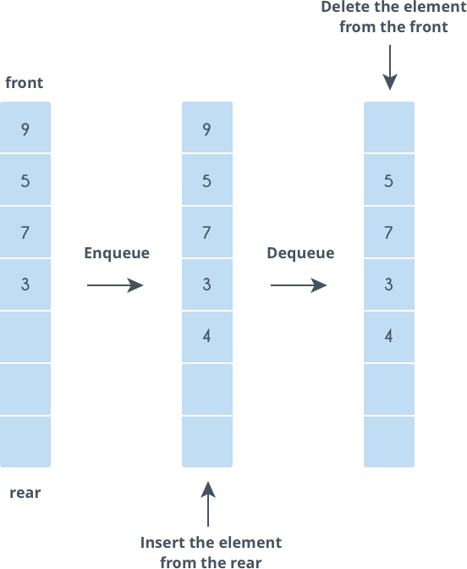
Operation
SLIDE 6 / 10
Add (Enqueue)
1
The Add operation inserts a new element at the rear end of the queue.
2
The rear pointer is incremented before the new element is stored in the array.
3
This operation checks for the Full condition to prevent overflow errors.
4
If the queue is empty, both front and rear are set to 0 initially.
5
The element is placed at the index indicated by the updated rear pointer.
Source: he-s3.s3.amazonaws.com
Chandigarh University
6 / 10
Notes:
When you Add an element, it goes to the rear end of the queue. The rear pointer is incremented before the new element is stored. We must check for the Full condition to prevent overflow errors. If the queue is empty, both front and rear are set to 0 initially.

Slide 7
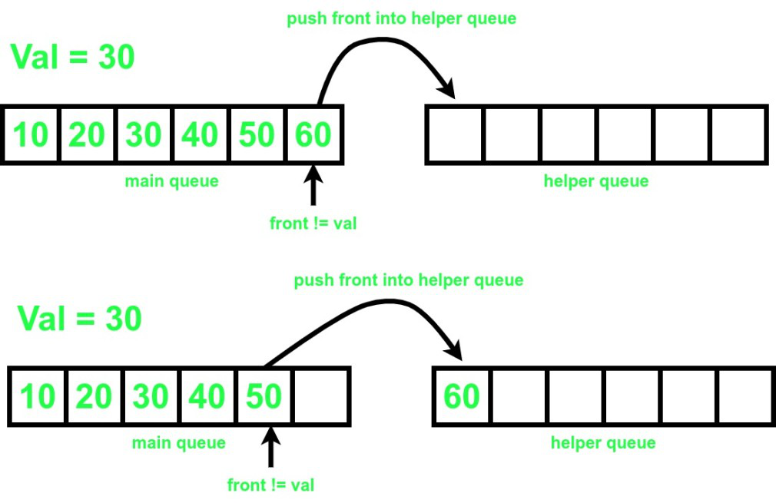
Operation
SLIDE 7 / 10
Delete (Dequeue)
1
The Delete operation removes the element currently at the front of the queue.
2
The front pointer is incremented to point to the next available element.
3
This operation checks for the Empty condition to prevent underflow errors.
4
If the queue becomes empty after deletion, both front and rear reset to -1.
5
The removed element is returned to the caller for further processing.
Source: media.geeksforgeeks.org
Chandigarh University
7 / 10
Notes:
The Delete operation removes the element at the front of the queue. The front pointer is incremented to point to the next available element. We check for the Empty condition to prevent underflow errors. If the queue becomes empty, both pointers reset to -1.

Slide 8
Condition
SLIDE 8 / 10
Full and Empty
1
The Empty condition is true when the front pointer equals -1.
2
The Full condition is true when the rear pointer equals the maximum size minus one.
3
These checks are critical before performing Add or Delete operations respectively.
4
In a circular queue, the Full condition involves checking if (rear + 1) % size equals front.
5
Proper handling of these conditions ensures data integrity and prevents runtime crashes.
Chandigarh University
8 / 10
Notes:
The Empty condition is true when the front pointer equals -1. The Full condition is true when the rear pointer equals the maximum size minus one. These checks are critical before performing Add or Delete operations. In a circular queue, the Full condition involves checking if the rear plus one modulo size equals front.

Slide 9
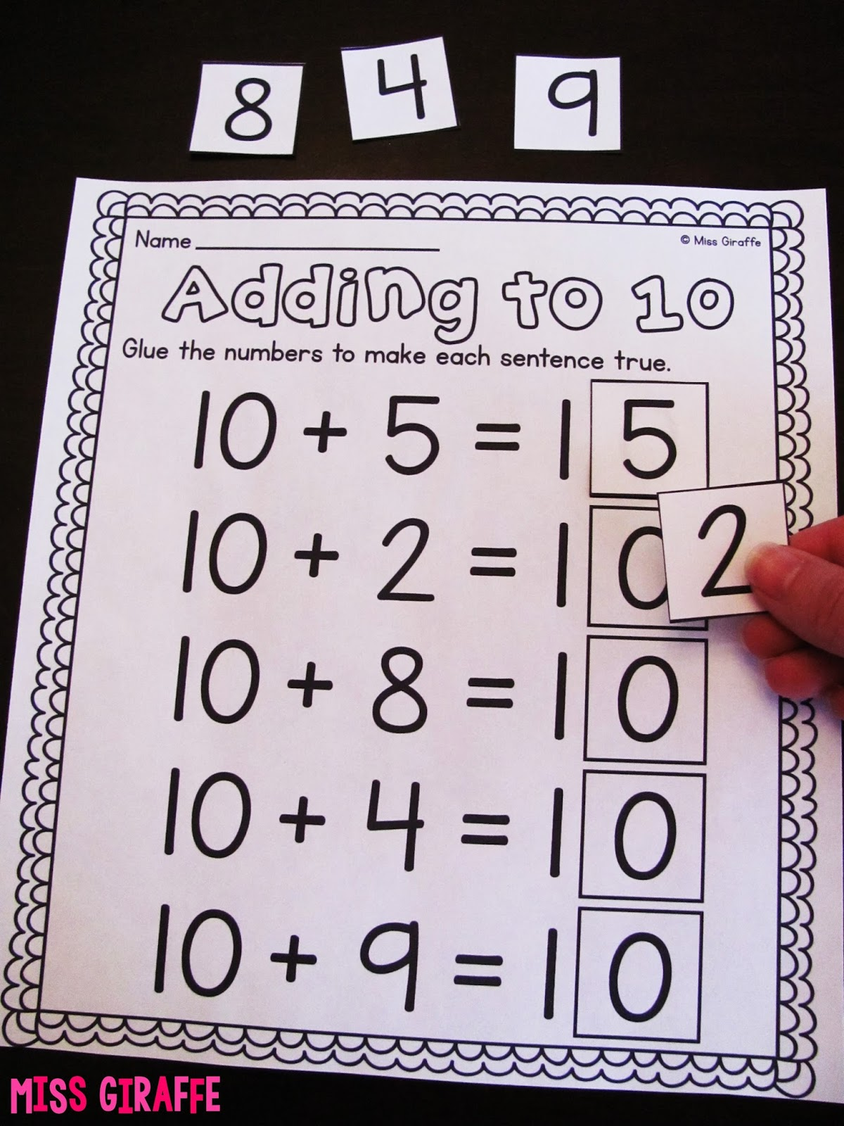
Worked Example
SLIDE 9 / 10
Queue Operations
GOVERNING EQUATION
Initial state: front = -1, rear = -1, Queue = [Empty]
CURRENT STATE
Queue contains only 20, ready for next Add or Delete.
• Add(10): rear becomes 0, Queue = [10], front = 0, rear = 0.
• Add(20): rear becomes 1, Queue = [10, 20], front = 0, rear = 1.
• Delete(): removes 10, front becomes 1, Queue = [20], front = 1, rear = 1.
Source: blogger.googleusercontent.com
Chandigarh University
9 / 10
Notes:
Let's trace a sequence: Start with front and rear at -1. Add 10, and the rear becomes 0. Add 20, and the rear becomes 1. Now, Delete removes 10, and the front moves to 1. The queue now contains only 20, ready for the next operation.

Slide 10
Lecture
SLIDE 10 / 10
References
DATA STRUCTURES
A Pseudocode Approach with C — Gilberg, Forouzan
• Data Structures — Lipschutz
• Data Structure Using C — AK Sharma
• C and Data structure — P. S. Deshpandey
Chandigarh University
10 / 10
Notes:
For further reading, please refer to the standard texts listed here. Gilberg and Forouzan provide a pseudocode approach with C. Lipschutz offers a comprehensive overview of data structures. Sharma and Deshpandey provide excellent C-specific implementations.

